Slide 1


One Stop For Every Bid
EY AUCTIONS
A new way to engage in auctions across india & world.

Slide 2

By
EyAuction.in
"EY Auctions" is an online auction web site aimed at taking the auction to the fingertips of aspiring bidders there by opening up the doors of the auctions to a wider range of products.
EyAuctions.in
Shivam Sharma || Aniket Kulshreshta

Slide 3


OUR BIG IDEA
The existing Auctions are managed manually. This conventional method most of the times prevent aspiring bidders from participating in the bidding process. The "EY Auctions" is online auction house so the seller or bidder doesn't need to go anywhere, instead they can take part in the auction just sitting in the comfort of their living room, be it during the day or night.

Slide 4



Target Audience(s)
Seller’s
Buyer’s
Mediocre’s
Global
Global
Global

Slide 5







Network Chart #ConnectingProfessionals
Sharda Linkedin
Mira Nitin
Want to sell something
Want to buy old but good quality products
Want to create profitable business
Businessmen
Mire Singh Want to do auctions of her old stuff
Ms Diksha
Wants to buy an iPhone
Krishna Wants to buy stuff in reasonable price
Yale
Want to sell her iPhone

Slide 6



Tech Requirements
HTML | CSS | JS
PHP | Servers
MySQL | Storage
For coding the dynamic and attractive UI of the website
For developing connections with the servers or we can say dynamic webpages
For Database Manipulation

Slide 7
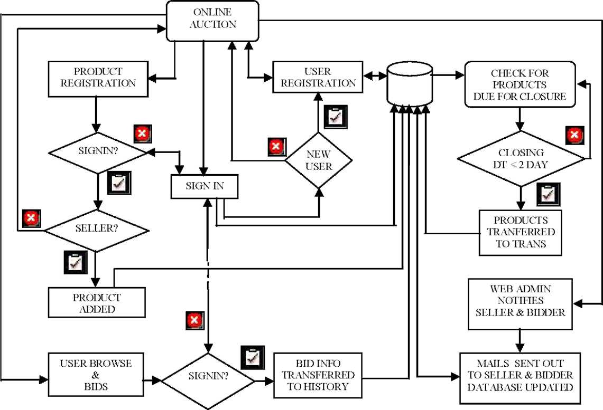
Working / Block Diagram

Slide 8

EyAuctions
Ey.In
A new way to engage in auctions across india & world.

